Slide 1
POC
-Manali M Jain

Slide 2
The Problem Statement
Requirement
Voice Assistant-- User gives voice commands and that is intern given to DL/ML model to retrieve the answer for user queries

Slide 3
Solution
For Developing Voice Assistant using Python and Deep learning

Slide 4
Implementation
Following are two approaches to solve the problem:
Using BERT pre trained model
Using Torch neural network model

Slide 5
Using BERT Pre-trained Model
Install cdqa,pandas,OS, azure-cognitive services-speech
Predict the answers for user’s queries
Download amazon financial data using Wget library
Predict the answers for questions
Install python cdqa libraries
Download pre-trained model BERT
Download preprocessed data
Create QA Pipeline
Fit the training data in model
BERT-Bidirectional encoder representation Transformer

Slide 6
Steps behind this approach:
1.Python
2.Setting up python and Jupyter IDE
3.Refreshing concepts of python like lists,tuples,sets,dictionaries
4.Installing CDQA(Closed Domain Question Answering System)
5.Requirements above packages were Joblib,Flask,pandas,numpy,sklearn,etc
6.Faced a lot of issues like Typeerror an integer is required(solving by downloading right version of joblib lib(dependency lib for cdqa)),java needed to installed for wget library to download the data.
7.Understood about cognitive services from azure and learnt how to embed the speech keys in code.
8.Transfer learning concept in Deep learning

Slide 7
Using Torch Neural Network model
Understood the concepts of Tokenization,Stemming and bag of words in NLP
Build a neural network model using Torch and trained the model with 1000 epochs
Consume the saved model to predict the answers for user’s questions
Study NLP Concepts
Create Training data
Pytorch model and training
Save /load the model
Implement voice chat
Created JSon data with key value pairs

Slide 8
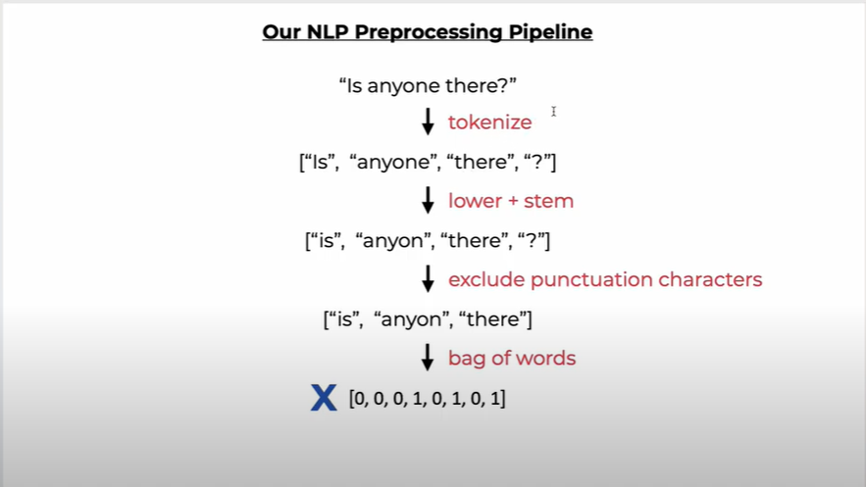

Slide 9
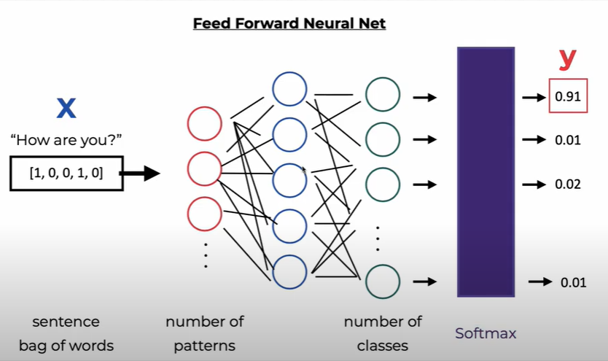

Slide 10
Steps behind this approach:
1.Installing NLTK
2.Understanding the concepts of NLP like Tokenization,Stemming and Bag of words
3.Creating own custom data related to one particular domain
4.Saw various internet videos regarding training the model
5.Preprocess the data before the data is fit into the model
6.Checking the device is with CUDA or CPU in the code
7.Understanding the hyper parameters in regularizing the model while training the model
8. Creating simple feed forward model using relu activation function
9.Saving the model rather than re-training the data
10.Using the saved model to predict and embedding speech recognition into it.

Slide 11
Thank You
It was great learning!!!

